Slide 1
Mining Large Graphs: Patterns, Anomalies, and Fraud Detection
Christos Faloutsos
CMU

Slide 2
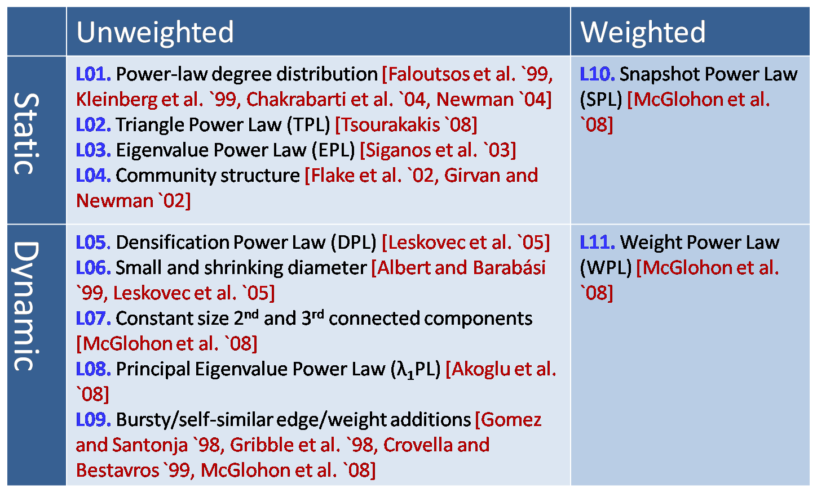
MORE Graph Patterns
✔
✔
✔
RTG: A Recursive Realistic Graph Generator using Random Typing Leman Akoglu and Christos Faloutsos. PKDD’09.

Slide 3
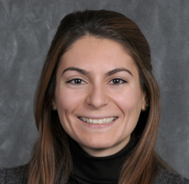
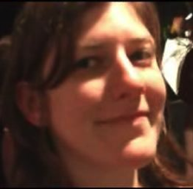
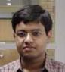
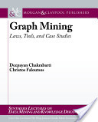
MORE Graph Patterns
Mary McGlohon, Leman Akoglu, Christos Faloutsos. Statistical Properties of Social Networks. in "Social Network Data Analytics” (Ed.: Charu Aggarwal)
Deepayan Chakrabarti and Christos Faloutsos, Graph Mining: Laws, Tools, and Case Studies Oct. 2012, Morgan Claypool.

Slide 4
CopyCatch

Slide 5
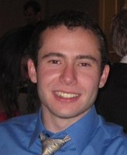
Fraud
Given
Who ‘likes’ what page, and when
Find
Suspicious users and suspicious products
CopyCatch: Stopping Group Attacks by Spotting Lockstep Behavior in Social Networks, Alex Beutel, Wanhong Xu, Venkatesan Guruswami, Christopher Palow, Christos Faloutsos WWW, 2013.

Slide 6


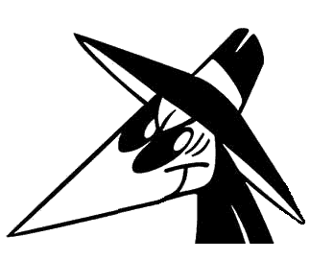




Fraud
Given
Who ‘likes’ what page, and when
Find
Suspicious users and suspicious products
Likes
CopyCatch: Stopping Group Attacks by Spotting Lockstep Behavior in Social Networks, Alex Beutel, Wanhong Xu, Venkatesan Guruswami, Christopher Palow, Christos Faloutsos WWW, 2013.

Slide 7
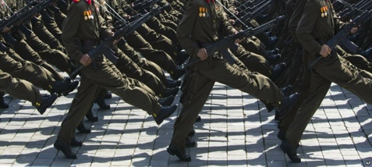
Graph Patterns and Lockstep Behavior
Our intuition
Lockstep behavior: Same Likes, same time
Likes
Notes:
Warming Hearts of Rockland
Beast – 1.5 million followers
Not real bad pages or data

Slide 8
Graph Patterns and Lockstep Behavior
Our intuition
Lockstep behavior: Same Likes, same time
Likes
Notes:
Warming Hearts of Rockland
Beast – 1.5 million followers
Not real bad pages or data

Slide 9
Graph Patterns and Lockstep Behavior
Our intuition
Lockstep behavior: Same Likes, same time
Likes
Suspicious Lockstep Behavior
Notes:
Warming Hearts of Rockland
Beast – 1.5 million followers
Not real bad pages or data

Slide 10





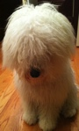
MapReduce Overview
Use Hadoop to search for many clusters in parallel:
Start with randomly seed
Update set of Pages and center Like times for each cluster
Repeat until convergence
Likes

Slide 11
Deployment at Facebook
CopyCatch runs regularly (along with many other security mechanisms, and a large Site Integrity team)
3 months of CopyCatch @ Facebook
#users
caught
time

Slide 12
Deployment at Facebook
Fake acct
Manually labeled 22 randomly selected
clusters from February 2013

Slide 13
Deployment at Facebook
Fake acct
Most clusters (77%) come from
real but compromised users
Manually labeled 22 randomly selected
clusters from February 2013

Slide 14
Fbox

Slide 15
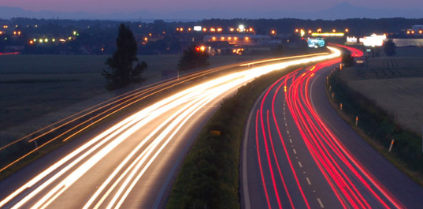
Roadmap
Introduction – Motivation
Part#1: Patterns in graphs
Patterns
Anomaly / fraud detection
CopyCatch
Spectral methods (‘fBox’)
Belief Propagation
Part#2: time-evolving graphs; tensors
Conclusions

Slide 16

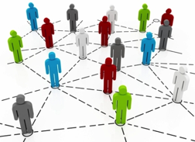

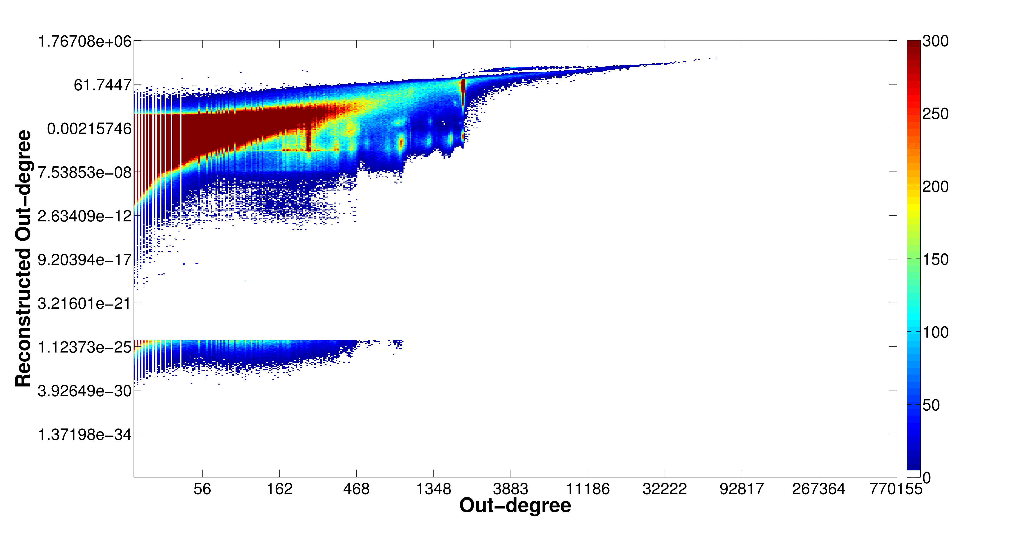
Problem: Social Network Link Fraud
Target: find “stealthy” attackers missed by other algorithms
Clique
41.7M nodes
1.5B edges
Bipartite
core

Slide 17
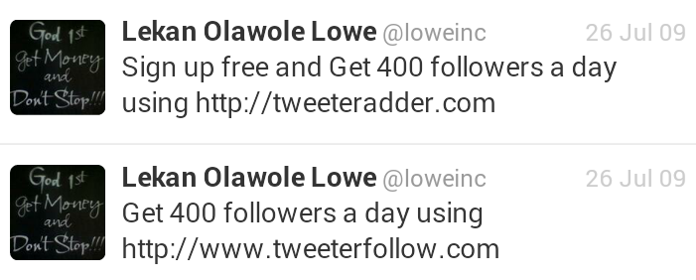

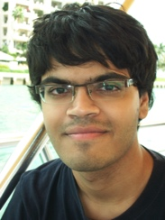
Problem: Social Network Link Fraud
Target: find “stealthy” attackers missed by other algorithms
Takeaway: use reconstruction error between true/latent representation!
Neil Shah, Alex Beutel, Brian Gallagher and Christos Faloutsos. Spotting Suspicious Link Behavior with fBox: An Adversarial Perspective. ICDM 2014, Shenzhen, China.
Notes:
Social networks with popularity incentives are plagued by the problem of link fraud, involving “bot” accounts falsely increasing popularity of a person or organization. These bots form cliques and bipartite cores in the graph structure. Several works have targeted the detection of large cases of fraud using spectral approaches like SVD, but fail to detect smaller, stealthier attacks due to computational restrictions on latent feature computation. Our approach, called fBox, leverages the reconstruction or projection error between latent, SVD representation and original graph representation to find anomalous bot accounts with high precision.

Slide 18
Roadmap
Introduction – Motivation
Part#1: Patterns in graphs
Patterns
Anomaly / fraud detection
CopyCatch
Spectral methods (‘fBox’, suspiciousness)
Belief Propagation
Part#2: time-evolving graphs; tensors
Conclusions

Slide 19
CrossSpot

Slide 20
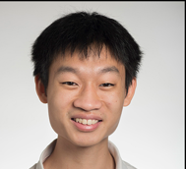
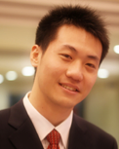
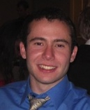

Suspicious Patterns in Event Data
?
2-modes
?
?
n-modes
A General Suspiciousness Metric for Dense Blocks in Multimodal Data, Meng Jiang, Alex Beutel, Peng Cui, Bryan Hooi, Shiqiang Yang, and Christos Faloutsos, ICDM, 2015.

Slide 21
Suspicious Patterns in Event Data
ICDM 2015
Which is more suspicious?
20,000 Users
Retweeting same 20 tweets
6 times each
All in 10 hours
225 Users
Retweeting same 1 tweet
15 times each
All in 3 hours
All from 2 IP addresses
vs.
Answer: volume * D_{KL}(p|| p_{background})

Slide 22

Suspicious Patterns in Event Data
ICDM 2015
Retweeting: “Galaxy Note Dream Project: Happy Happy Life Traveling the World”

Slide 23
Roadmap
Introduction – Motivation
Part#1: Patterns in graphs
Patterns
Anomaly / fraud detection
CopyCatch
Spectral methods (‘fBox’)
Belief Propagation
Part#2: time-evolving graphs; tensors
Conclusions

Slide 24
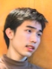
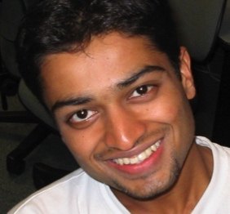
E-bay Fraud detection
w/ Polo Chau &
Shashank Pandit, CMU
[www’07]

Slide 25
E-bay Fraud detection

Slide 26
E-bay Fraud detection

Slide 27
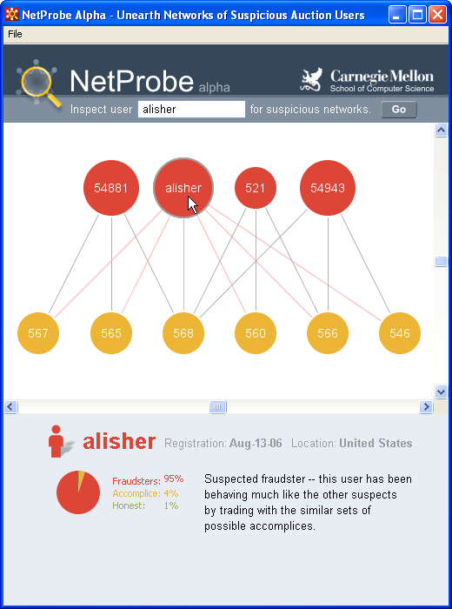
E-bay Fraud detection - NetProbe

Slide 28


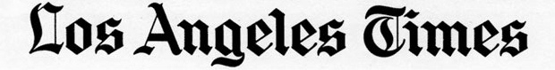
Popular press
And less desirable attention:
E-mail from ‘Belgium police’ (‘copy of your code?’)

Slide 29
Roadmap
Introduction – Motivation
Part#1: Patterns in graphs
Patterns
Anomaly / fraud detection
CopyCatch
Spectral methods (‘fBox’)
Belief Propagation; antivirus app
Part#2: time-evolving graphs; tensors
Conclusions

Slide 30
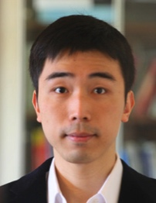
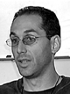


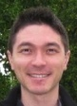
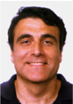
Polonium: Tera-Scale Graph Mining and Inference for Malware Detection
PATENT PENDING
SDM 2011, Mesa, Arizona
Polo Chau
Machine Learning Dept
Carey Nachenberg
Vice President & Fellow
Jeffrey Wilhelm
Principal Software Engineer
Adam Wright
Software Engineer
Prof. Christos Faloutsos
Computer Science Dept

Slide 31
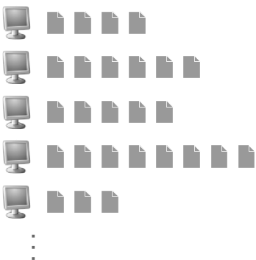
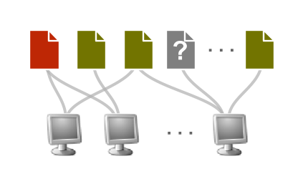
Polonium: The Data
Ç√
60+ terabytes of data anonymously contributed by participants of worldwide Norton Community Watch program
50+ million machines
900+ million executable files
Constructed a machine-file bipartite graph (0.2 TB+)
1 billion nodes (machines and files)
37 billion edges
Ç√
Ç√
Notes:
As of today, has grown to more than three times

Slide 32
Polonium: Key Ideas
Use Belief Propagation to propagate domain knowledge in machine-file graph to detect malware
Use “guilt-by-association” (i.e., homophily)
E.g., files that appear on machines with many bad files are more likely to be bad
Scalability: handles 37 billion-edge graph

Slide 33
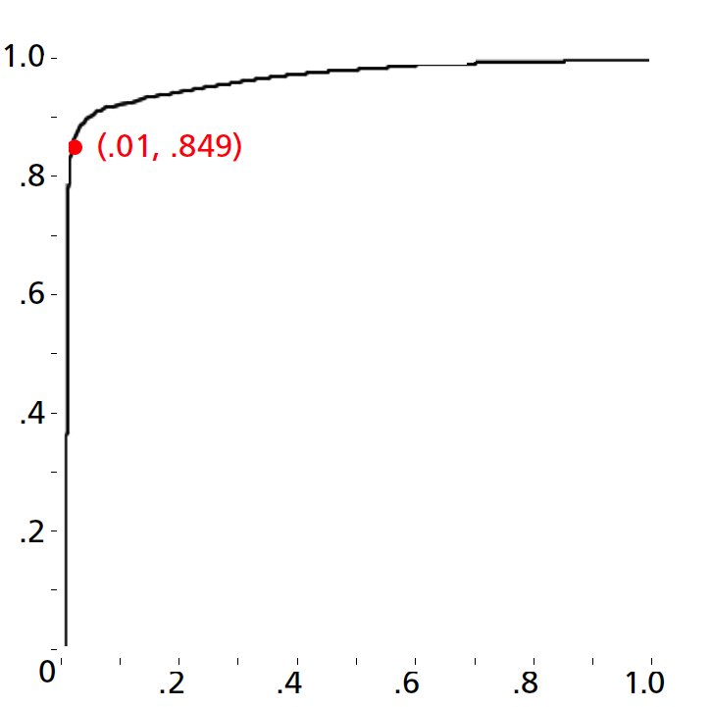
Polonium: One-Interaction Results
Ideal
84.9% True Positive Rate 1% False Positive Rate
True Positive Rate
% of malware correctly identified
False Positive Rate
% of non-malware wrongly labeled as malware
Notes:
for files reported by four or more machines

Slide 34
Roadmap
Introduction – Motivation
Part#1: Patterns in graphs
Patterns
Anomaly / fraud detection
CopyCatch
Spectral methods (‘fBox’)
Belief Propagation; financial fraud
Part#2: time-evolving graphs; tensors
Conclusions

Slide 35
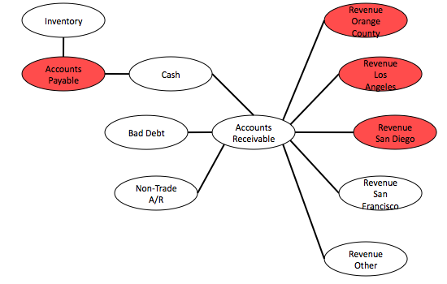
Network Effect Tools: SNARE
Some accounts are sort-of-suspicious – how to combine weak signals?
Before

Slide 36
Network Effect Tools: SNARE
A: Belief Propagation.
Before

Slide 37
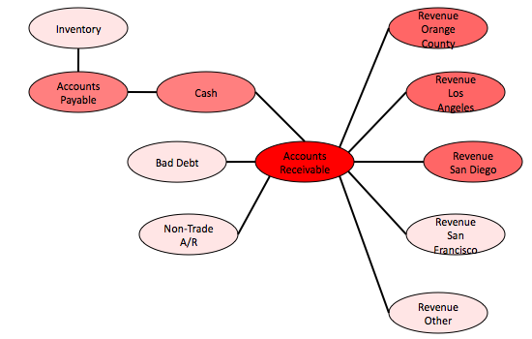
Network Effect Tools: SNARE
A: Belief Propagation.
Before
After
Mary McGlohon, Stephen Bay, Markus G. Anderle, David M. Steier, Christos Faloutsos: SNARE: a link analytic system for graph labeling and risk detection. KDD 2009: 1265-1274

Slide 38
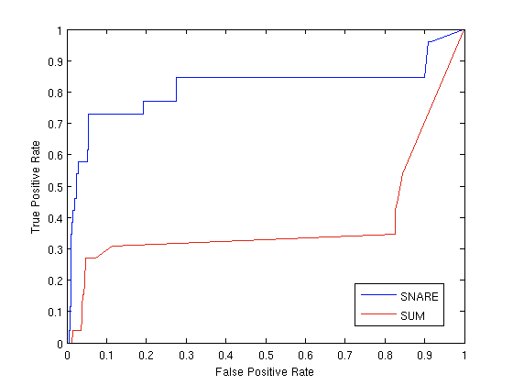
Network Effect Tools: SNARE
Produces improvement over simply using flags
Up to 6.5 lift
Improvement especially for low false positive rate
Results for accounts data (ROC Curve)
Ideal
SNARE
Baseline (flags only)
True positive rate
False positive rate

Slide 39
Network Effect Tools: SNARE
Accurate- Produces large improvement over simply using flags
Flexible- Can be applied to other domains
Scalable- One iteration BP runs in linear time (# edges)
Robust- Works on large range of parameters

Slide 40
Roadmap
Introduction – Motivation
Part#1: Patterns in graphs
Patterns
Anomaly / fraud detection
CopyCatch
Spectral methods (‘fBox’)
Belief Propagation; fast computation & unification
Part#2: time-evolving graphs; tensors
Conclusions

Slide 41
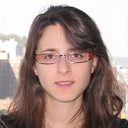
Unifying Guilt-by-Association Approaches: Theorems and Fast Algorithms
Danai Koutra
U Kang
Hsing-Kuo Kenneth Pao
Tai-You Ke
Duen Horng (Polo) Chau
Christos Faloutsos
ECML PKDD, 5-9 September 2011, Athens, Greece
Notes:
Work in collaboration with National Taiwan University

Slide 42
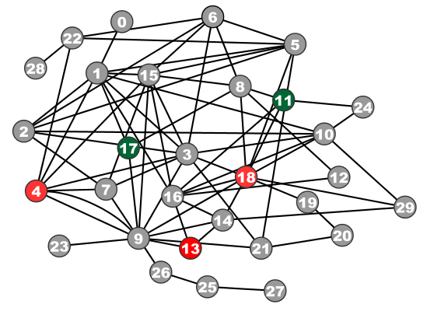
Problem Definition: GBA techniques
?
Given: Graph; &
few labeled nodes
Find: labels of rest
(assuming network effects)
?
?
?
Notes:
Classification problem where we assume that neighboring nodes are related
Network effects – birds of a feather flock together

Slide 43

Are they related?
RWR (Random Walk with Restarts)
google’s pageRank (‘if my friends are important, I’m important, too’)
SSL (Semi-supervised learning)
minimize the differences among neighbors
BP (Belief propagation)
send messages to neighbors, on what you believe about them

Slide 44
Are they related?
YES!
RWR (Random Walk with Restarts)
google’s pageRank (‘if my friends are important, I’m important, too’)
SSL (Semi-supervised learning)
minimize the differences among neighbors
BP (Belief propagation)
send messages to neighbors, on what you believe about them

Slide 45
Correspondence of Methods
Method | Matrix |  | Unknown |  | known
RWR | [I – c AD⁻¹] | × | x | = | (1-c)y
SSL | [I + a(D - A)] | × | x | = | y
FABP | [I + a D - c’A] | × | b_{h} | = | φ_{h}
1
1
1
d1
d2
d3
0 1 0
1 0 1
0 1 0
?
0
1
1
adjacency matrix
final labels/ beliefs
prior labels/ beliefs

Slide 46

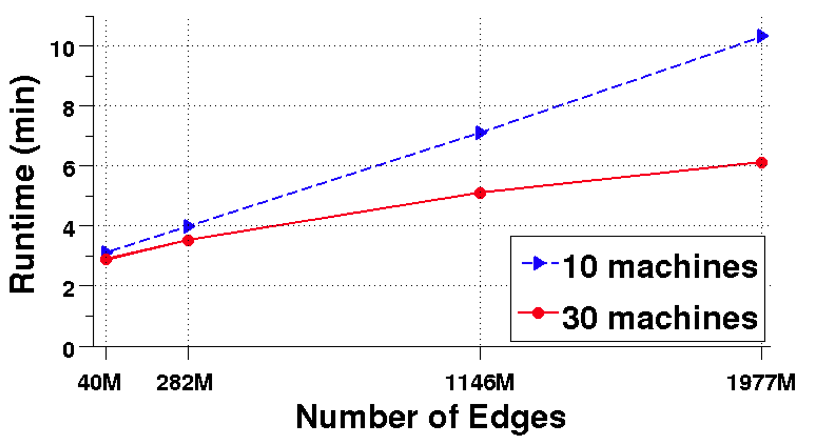
Results: Scalability
runtime (min)
# of edges (Kronecker graphs)
FABP is linear on the number of edges.
Notes:
Kronecker graphs

Slide 47
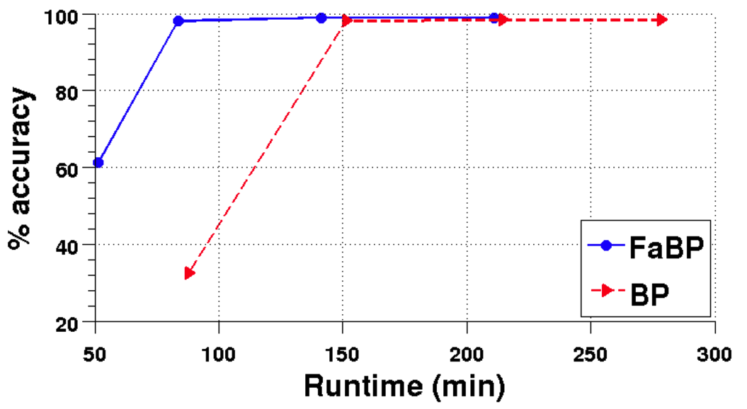
Results: Parallelism
% accuracy
runtime (min)
FABP ~2x faster
& wins/ties on accuracy.

Slide 48
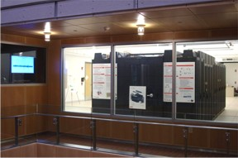

Summary of Part#1
*many* patterns in real graphs
Power-laws everywhere
Gaussian trap
Avg << Max
Long (and growing) list of tools for anomaly/fraud detection
Patterns anomalies

Slide 49
Roadmap
Introduction – Motivation
Part#1: Patterns in graphs
Part#2: time-evolving graphs; tensors
P2.1: time-evolving graphs
[P2.2: with side information (‘coupled’ M.T.F.)
Speed]
Conclusions

Slide 50
Part 2:
Time evolving
graphs; tensors

Slide 51
Graphs over time -> tensors!
Problem #2.1:
Given who calls whom, and when
Find patterns / anomalies
johnson
smith

Slide 52
Graphs over time -> tensors!
Problem #2.1:
Given who calls whom, and when
Find patterns / anomalies

Slide 53
Graphs over time -> tensors!
Problem #2.1:
Given who calls whom, and when
Find patterns / anomalies
Tue
Mon

Slide 54
Graphs over time -> tensors!
Problem #2.1:
Given who calls whom, and when
Find patterns / anomalies
time
caller
callee

Slide 55
Graphs over time -> tensors!
Problem #2.1’:
Given author-keyword-date
Find patterns / anomalies
date
MANY more settings,
with >2 ‘modes’
author
keyword

Slide 56
Graphs over time -> tensors!
Problem #2.1’’:
Given subject – verb – object facts
Find patterns / anomalies
verb
MANY more settings,
with >2 ‘modes’
subject
object

Slide 57
Graphs over time -> tensors!
Problem #2.1’’’:
Given <triplets>
Find patterns / anomalies
mode3
MANY more settings,
with >2 ‘modes’
(and 4, 5, etc modes)
mode1
mode2

Slide 58
Graphs & side info
SKIP
Problem #2.2: coupled (eg., side info)
Given subject – verb – object facts
And voxel-activity for each subject-word
Find patterns / anomalies
verb
subject
object
fMRI voxel activity
`apple tastes sweet’

Slide 59
Graphs & side info
SKIP
Problem #2.2: coupled (eg., side info)
Given subject – verb – object facts
And voxel-activity for each subject-word
Find patterns / anomalies
`tastes’
‘apple’
‘apple’
‘sweet’
fMRI voxel activity
`apple tastes sweet’

Slide 60
Roadmap
Introduction – Motivation
Part#1: Patterns in graphs
Part#2: time-evolving graphs; tensors
P2.1: time-evolving graphs
[P2.2: with side information (‘coupled’ M.T.F.)
Speed]
Conclusions

Slide 61
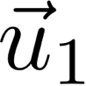
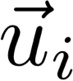
Answer to both: tensor factorization
Recall: (SVD) matrix factorization: finds blocks
‘meat-eaters’
‘steaks’
‘vegetarians’
‘plants’
‘kids’
‘cookies’
M
products
N
users
+
+
~

Slide 62
Answer to both: tensor factorization
PARAFAC decomposition
politicians
artists
athletes
verb
subject
+
+
=
object

Slide 63
Answer: tensor factorization
PARAFAC decomposition
Results for who-calls-whom-when
4M x 15 days
??
??
??
time
caller
+
+
=
callee

Slide 64
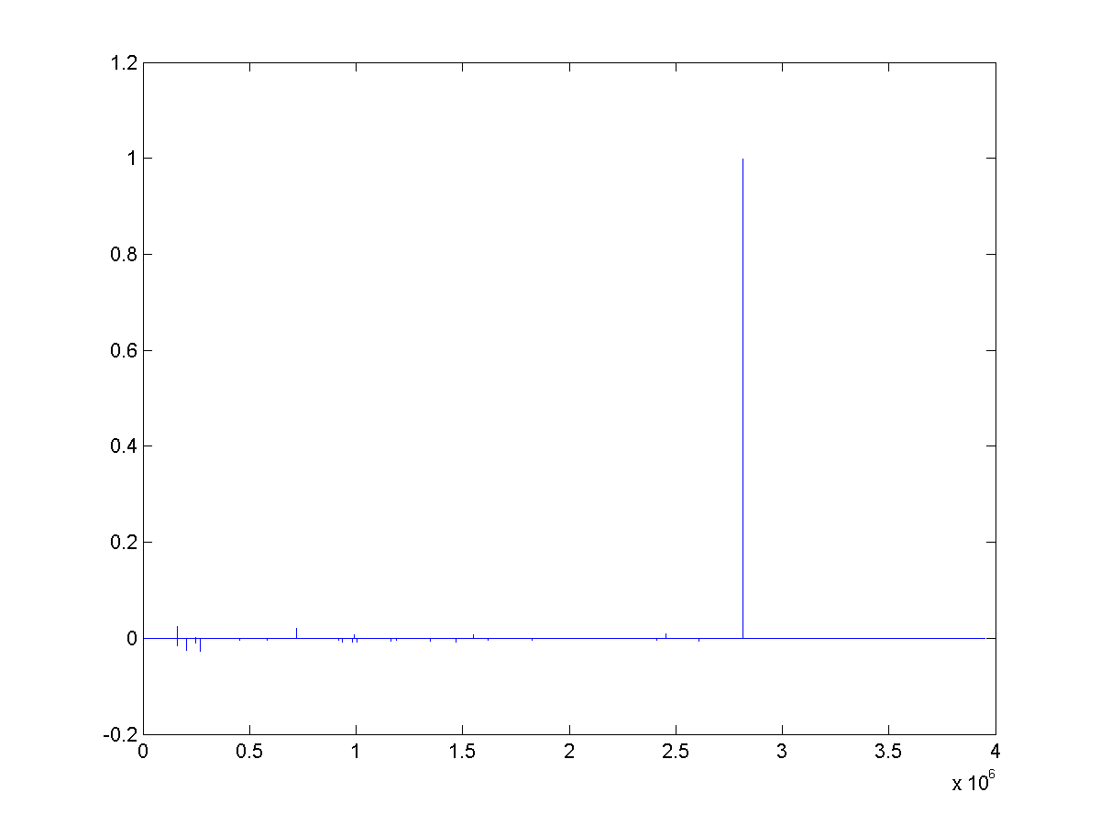
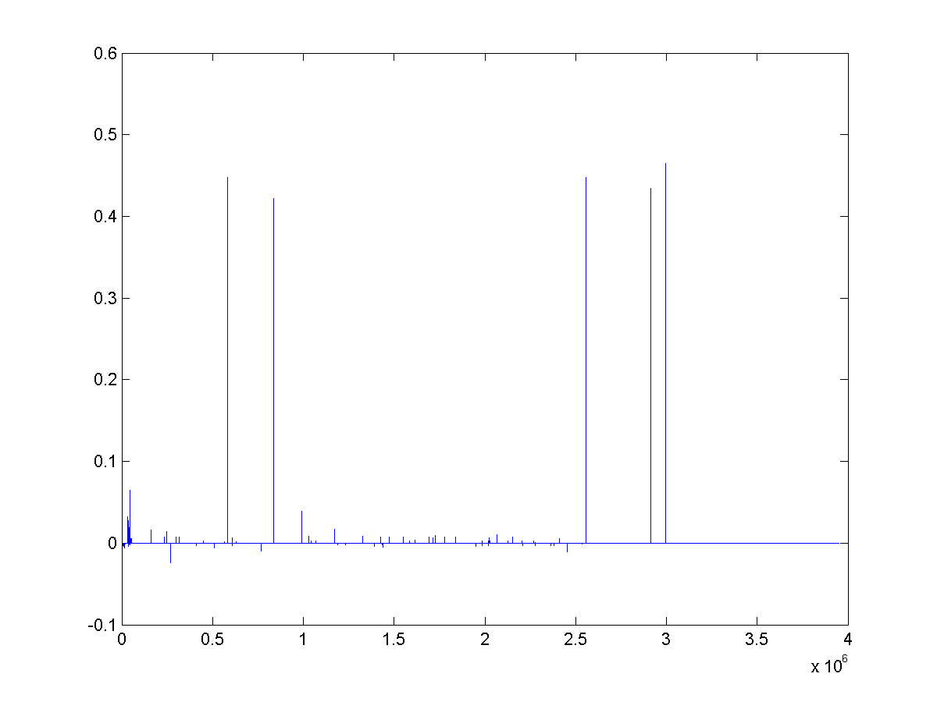
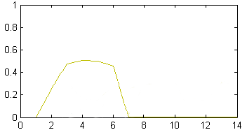
Anomaly detection in time-evolving graphs
=
Anomalous communities in phone call data:
European country, 4M clients, data over 2 weeks
~200 calls to EACH receiver on EACH day!
1 caller
5 receivers
4 days of activity

Slide 65
Anomaly detection in time-evolving graphs
=
Anomalous communities in phone call data:
European country, 4M clients, data over 2 weeks
~200 calls to EACH receiver on EACH day!
1 caller
5 receivers
4 days of activity

Slide 66
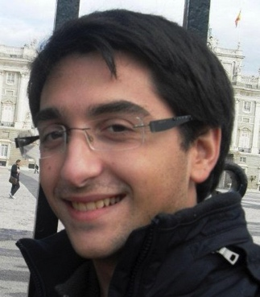

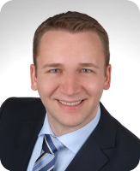
Anomaly detection in time-evolving graphs
=
Anomalous communities in phone call data:
European country, 4M clients, data over 2 weeks
~200 calls to EACH receiver on EACH day!
Miguel Araujo, Spiros Papadimitriou, Stephan Günnemann, Christos Faloutsos, Prithwish Basu, Ananthram Swami,
Evangelos Papalexakis, Danai Koutra. Com2: Fast Automatic Discovery of Temporal (Comet) Communities. PAKDD 2014, Tainan, Taiwan.

Slide 67
Roadmap
Introduction – Motivation
Part#1: Patterns in graphs
Part#2: time-evolving graphs; tensors
P2.1: Discoveries @ phonecall network
[P2.2: Discoveries in neuro-semantics
Speed]
Conclusions

Slide 68

Coupled Matrix-Tensor Factorization (CMTF)
c₁
c_{F}
timestamp
User-attr.
Y
b₁
b_{F}
user
X
+
product
a₁
a_{F}
d₁
d_{F}
+
a₁
a_{F}

Slide 69
Coupled Matrix-Tensor Factorization (CMTF)
c₁
c_{F}
Y
b₁
b_{F}
X
+
a₁
a_{F}
d₁
d_{F}
+
a₁
a_{F}

Slide 70
Part 2: Conclusions
Time-evolving / heterogeneous graphs -> tensors
PARAFAC finds patterns
(GigaTensor/HaTen2 -> fast & scalable)
=

Slide 71
Roadmap
Introduction – Motivation
Why study (big) graphs?
Part#1: Patterns in graphs
Part#2: time-evolving graphs; tensors
Acknowledgements and Conclusions

Slide 72








Thanks
Disclaimer: All opinions are mine; not necessarily reflecting the opinions of the funding agencies
Thanks to: NSF IIS-0705359, IIS-0534205,
CTA-INARC; Yahoo (M45), LLNL, IBM, SPRINT, Google, INTEL, HP, iLab

Slide 73
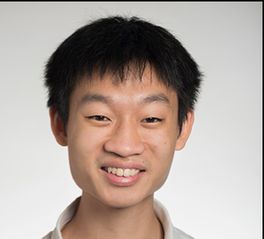

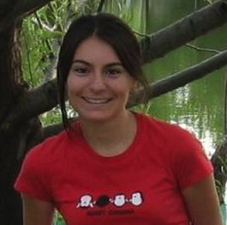

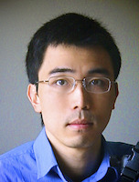
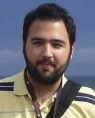
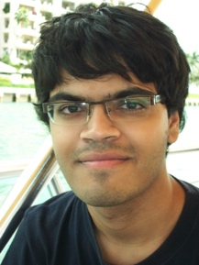
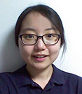
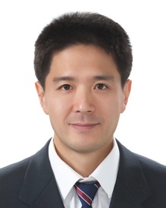
Cast
Akoglu,
Leman
Araujo,
Miguel
Beutel,
Alex
Chau,
Polo
Hooi,
Bryan
Koutra,
Danai
Papalexakis,
Vagelis
Shah,
Neil
Kang, U
Song,
Hyun Ah

Slide 74


Cast
Akoglu,
Leman
Araujo,
Miguel
Beutel,
Alex
Chau,
Polo
Eswaran,
Dhivya
Hooi,
Bryan
Kang, U
Koutra,
Danai
Papalexakis,
Vagelis
Shah,
Neil
Shin,
Kijung
Song,
Hyun Ah

Slide 75




CONCLUSION#1 – Big data
Patterns Anomalies
Large datasets reveal patterns/outliers that are invisible otherwise

Slide 76
CONCLUSION#2 – tensors
powerful tool
=
1 caller
5 receivers
4 days of activity

Slide 77

References
D. Chakrabarti, C. Faloutsos: Graph Mining – Laws, Tools and Case Studies, Morgan Claypool 2012
http://www.morganclaypool.com/doi/abs/10.2200/S00449ED1V01Y201209DMK006

Slide 78


TAKE HOME MESSAGE:
Cross-disciplinarity
=

